Slide 1
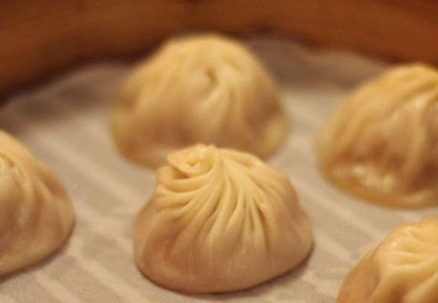

Din Tai Fung’s competitors in Seattle

Slide 2
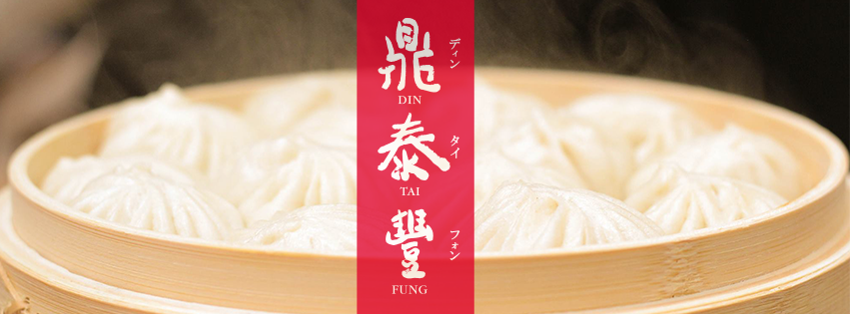
What is Din Tai Fung?
Din Tai Fung is one of the most famous dumpling places around the world.
Nowadays, Din Tai Fung has branches in Japan, the United States, South Korea, Singapore, China, Hong Kong, Indonesia, Malaysia, Australia and Thailand.
In Seattle, for example, there are already 4 branches of Din Tai Fung.

Slide 3
Understanding Din Tai Fung’s Competitors is valuable for the business.
Din Tai Fung can conduct better competitor analysis in order to improve their competitiveness in Seattle
Din Tai Fung can identify who they should be paying close attention to
Din Tai Fung can adjust their business strategies in response to its competitors’ current situation

Slide 4
Data Acquisition and Cleaning
Main Source
 | count | ratings | price
Dough Zone Dumpling House | 6 | 8.40 | 11.25
Pel’Meni Dumpling Tzar | 2 | 7.55 | 0*
Yang’s Dumpling House | 1 | 6.30 | 8.99
Dumpling Generation | 1 | 7.10 | 0*
Dumplings of Fury | 1 | 7.90 | 9.00
Little Ting’s Dumplings | 1 | 8.00 | 11.59
Ping’s Dumpling House & Market | 1 | 5.40 | 8.99
China Dumpling& Noodle House | 1 | 6.30 | 7.95
Din Tai Fung | 4 | 8.83 | 10.50
Foursquare API
Yelp
Restaurants’ Official Websites
Google
where Count stands for the number of branches, Ratings stands for the average rating of all the branches for a restaurant, and Price is the specialty dish’s price($) in a restaurant.
* No corresponding dish as Din Tai Fung’s specialty ( Pork Soup Dumplings)

Slide 5

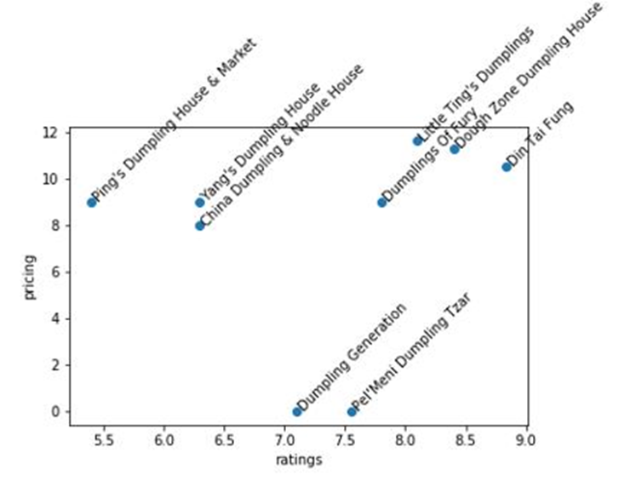
Exploratory Data Analysis
Din Tai Fung is very close to Dough Zone Dumpling House, Dumplings of Fury, and Little Ting’s Dumplings.
They might be clustered as a group with Din Tai Fung and be considered as the biggest competitors with Din Tai Fung.
However, further information still needs to be considered, such as the size of the brand.

Slide 6
K-Means Clustering
Why and How?
 | Cluster Label
Dough Zone Dumpling House | 0
Pel’Meni Dumpling Tzar | 1
Yang’s Dumpling House | 2
Dumpling Generation | 1
Dumplings of Fury | 2
Little Ting’s Dumplings | 2
Ping’s Dumpling House & Market | 2
China Dumpling& Noodle House | 2
Din Tai Fung | 0
We want to know the feature similarity of the dumpling restaurants and group the similar ones together.
The features we are considering are the number of branches, average rating of all the branches, and pricing.
K=3

Slide 7

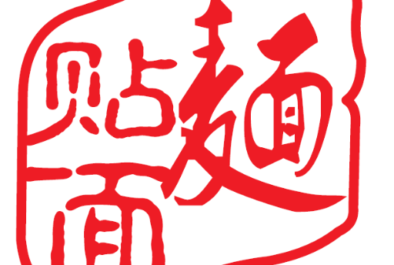
Conclusion and Recommendations
Dough Zone Dumpling House is the only one that is clustered in the same group as Din Tai Fung, hence it is Din Tai Fung’s biggest direct competitor in Seattle.
Din Tai Fung can improve their business in the following ways:
Expand their business in Seattle
Din Tai Fung can increase their general pricing level slightly higher than their current level but no more than Dough Zone Dumpling House’s pricing level.
Shortening the wait time

